Slide 1
Network Security
Group 5
Software
2018
SECURITY

Slide 2
Team Member and Division
/01

Slide 3
Team Member and Division
IP Security
DNS Security
刘龙权
刘益铭
龙思怡
凌赵奇
DoS & DDoS
PowerPoint
刘昱玮
刘玮琦
刘岳
卢垚松
Basic & Future
刘圃卓

Slide 4

Team Member and Division

Slide 5
Team Member and Division
Git 截图

Slide 6
How the network works
/02

Slide 7
How the network works
Communication
Package
Through the parcel of layer protocol
Split and assembled at the destination
Basic
Computer Interconnection
Wired: dial-up connection, optical fiber
Wireless: wifi, data network

Slide 8
IP Security
/03

Slide 9
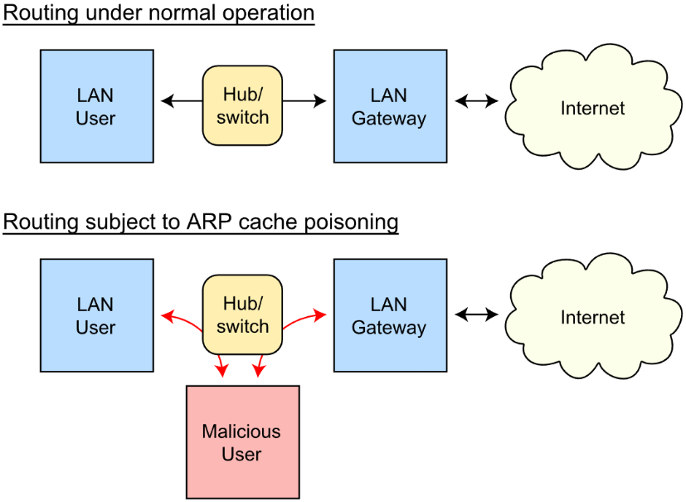
IP Security
Data Sniffer
Promiscuous
Mode
Set the network card to promiscuous mode to receive all packets.
Only in hub.
ARP Cache Poisoning
Arp cache is destroyed by the malicious host.
In switch.

Slide 10
IP Security
IP
Fraud
Attacker gains information or trust by fake IP or packages.
The way of IP fraud
Fake IP address; Source routing attack;
Trust in Unix
Tools
Nmap
HPing
Nemesis
Spoofer
Engage Packet Builder
IRPAS
IRPAS
The prevention of IP fraud
Random SYN; Packet filtering; Discard address-based trust
Encryption & verification protocol: IPSec; SSL
Relation work
FHSD: An Improved IP Spoof Detection Met-hod for Web DDoS Attacks
Systems and methods for ip source address spoof detection
Towards a SDN-Based Integrated Architect-ure for Mitigating IP Spoofing Attack

Slide 11
DNS Security
/03

Slide 12
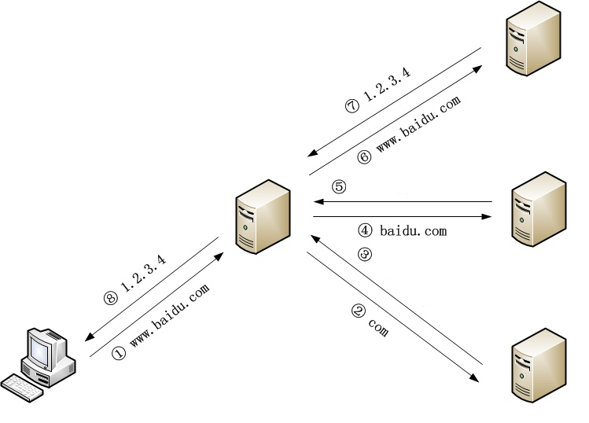
DNS Security
Vulnerability of DNS
Insecure UDP protocol
DNSSEC is not popularize
Malicious using of DNS
Use the server for DDoS attacks.
Use the server for botnet communication.
Redirect to a malicious website.
DNS redirection
Authoritative server
IP address of Authoritative server
Forged DNS server response
Recursive server
TLD Authoritative server
IP address of TLD server
Modify the recursive server cache
Client
DNS Root server

Slide 13
(Distributed) Denial of Service
/04

Slide 14
(Distributed) Denial of Service
(D)DoS
Sends a lot of information to the target to crash the server.
Traditional DoS
SYN Flood; ACK Flood
UDP Flood; Challenge Collapsar
Reflective DDoS
Recent DoS
Attacker
Reflective DDoS
WebSocket DDoS
Fake IP
Prevention
Increase connection overhead
Invalid for DDoS
ISP filtering
Significantly reduced bandwidth
Refuse to forward fake packets
Need huge changes to protocol
Server1, 2, … , N
Huge data package
Victim

Slide 15
(Distributed) Denial of Service
Demonstration of SYN Flood
Use lots of fake IP for the first handshake in TCP.
Tools
Mininet; Netwox; Openbsd-inetd; Telnetd
Steps
Start mininet to create a network with one router s1 and three terminals h1, h2, h3.
Start telnet on h2.
Use telnet to verify that h2 can be linked by h3.
Use netwox to attack h2 through h1.

Slide 16
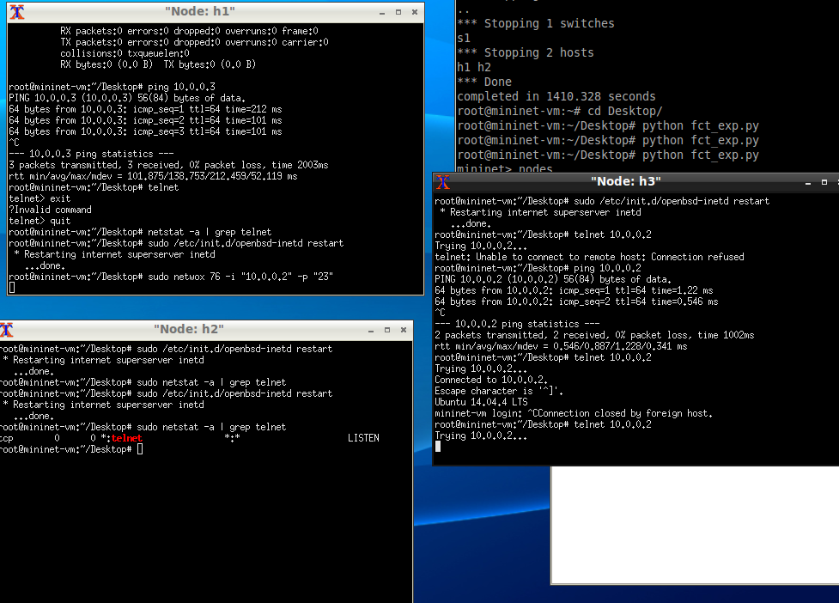
(Distributed) Denial of Service
Result of SYN Flood
After the attack, h3 could not link to h2.

Slide 17
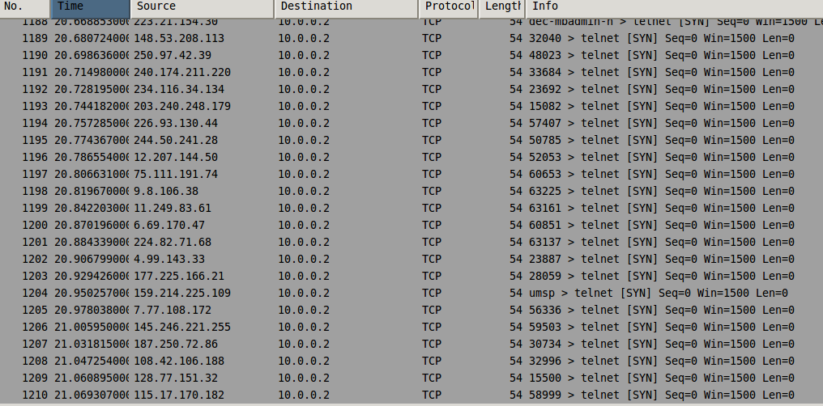
(Distributed) Denial of Service
Result of SYN Flood
Found a large number of SYN packages by wireshark.

Slide 18
Future of Network Seurity
/05

Slide 19
Future of Network Seurity
Trends of cyber threat
Network attacks combined with physical attacks
AI Malware
IoT Security
Social Engineering.
Responses
Cybersecurity law
Network security professionals
Identity Authentication
Secure Protocol
Cooperation with AI

Slide 20
Network Security Group 5
THANKS
Software Security
2018

